Slide 1










The Ultimate Travel Route Visualization Dashboard
Maruti Biswas Sarah Demmon Paola Roman Chantal Thomas

Slide 2
PROJECT CONCEPT

Slide 3
Our aim was to build a travel route search engine with helpful visualizations to guide the trip selection process.
With so many flights departing from each airport, this tool has the potential to really help travelers find the most direct route of travel.

Slide 4
PURPOSE

Slide 5
We believe that…
Travelers that hate layovers wish to see only NON-STOP flights
It’s useful to model travel in an easy to consume way without pricing information to distract their goal

Slide 6
DATA SOURCES

Slide 7
DATA SOURCES
OpenFlights
OpenFlights Airports Database contains over 10,000 airports spanning the globe
Developed to store free airport, airline, and route data
This is where we sourced the CSV file which we converted to JSON files
StackOverflow Discussion Forums
Free Code Camp
W3Schools
JavaScriptTutorial.net
IATA Airline and Airport Code Search

Slide 8
VISUALIZATIONS WE BUILT
IATA (International Airport Transportation Association) Code Search
w/ Map
2. Airport Info At-A-Glance (airport name, altitude, city, country, altitude, time zone)
3. Top Destinations Graph
4. Top Airlines Graph
5. IATA Code Cheat Sheet

Slide 9
LIVE DEMO (2-3mins)

Slide 10
A PEEK AT OUR CODE

Slide 11
APP.JS
document.addEventListener("DOMContentLoaded", function() {
// initializing map
var map = L.map('map').setView([0, 0], 2);
// adding tile layer to map
L.tileLayer('https://{s}.tile.openstreetmap.org/{z}/{x}/{y}.png', {
attribution: 'Map data &copy; <a href="https://www.openstreetmap.org/">OpenStreetMap</a> contributors'
}).addTo(map);
// creating a marker to point to input airport
var sourceMarker;
// create a function to plot marker, add polylines ro map and erase all previous markers and lines
function plotRoutes(routesData, airportsData, airlinesData) {
// clear any markers and polylines that were there when the button is clicked
if (sourceMarker) {
map.removeLayer(sourceMarker);
}
map.eachLayer(function(layer) {
if (layer instanceof L.Polyline) {
map.removeLayer(layer);
}
});
// getting the iata code from user and converting it to uppercase
var airportCode = document.getElementById('airportCode').value.toUpperCase();
//finding the input airport in the openflights airport data as it appears as airport code
var sourceAirport = airportsData.find(function(airport) {
return airport.iata === airportCode;
});
// creating a number of routes counter by input airport
var numRoutes = routesData.filter(function(route) {
return route.source_airport === airportCode;
}).length;
// plotting the marker for the input airport on the map with a popup that displays the airport name and airport code
sourceMarker = L.marker([sourceAirport.lat, sourceAirport.lon]).addTo(map).bindPopup(sourceAirport.airport_id + ' (' + airportCode + ')');
displayAirportInfo(sourceAirport, numRoutes);
//getting all flights with the same source airport
routesData.forEach(function(route) {
// if the source aiport is the same as the airport code get the destination airport
if (route.source_airport === airportCode) {
var destinationAirport = airportsData.find(function(airport) {
return airport.iata === route.destination_airport;
});
// get the lat and lon values for source airport and the destination airport from opneflights airports json
if (destinationAirport) {
var latlngs = [
[sourceAirport.lat, sourceAirport.lon],
[destinationAirport.lat, destinationAirport.lon]
];
// plotting the polylines from source airport to destination lat and lon
L.polyline(latlngs, { color: 'red', opacity: 0.3, weight: 2 }).addTo(map);
}
}
});
// running the charts functions for display
buildDestinationsChart(airportCode, routesData, airportsData);
buildAirlinesChart(airportCode, routesData, airlinesData);
}

Slide 12
INDEX.HTML
<div class="container">
<div class="row">
<div style="background : #8ea3d8be" class="col-md-12 jumbotron text-center">
<h1 font face="Arial">Airport Calculator</h1>
<p font face="Arial">Let's explore the airports of the world! Use the interactive charts below to explore the OpenFlights dataset</p>
</div>
</div>
<div class="row">
<div class="col-md-2">
<div class="well">
<h5>Please enter IATA airport code below</h5>
<input type="text" style="font-family: Arial" id="airportCode" placeholder="E.g., JFK" />
<button id="plotButton" style="font-family: Arial">Plot Routes</button><a href="airportcodes.html" target="_blank">Airport Code Search</a>
</div>
<div class="panel panel-primary">
<div class="panel-heading">
<h3 class="panel-title" font face="Arial">Airport Info</h3>
</div>
<div id="sample-metadata" class="panel-body"></div>
</div>
</div>
<div id="charts-container" class="col-md-10">
<div id="bar1"></div>
<div id="bar2"></div>
</div>
</div>
<div id="map-container">
<div id="map"></div>
</div>
</div>
<script src="https://d3js.org/d3.v7.min.js"></script>
<script src="https://cdn.plot.ly/plotly-latest.min.js"></script>
<script src="https://cdnjs.cloudflare.com/ajax/libs/leaflet/1.7.1/leaflet.js"></script>
<script src = "app.js"></script>
</body>
</html>

Slide 13
KEY TAKEAWAYS

Slide 15
FUTURE IMPROVEMENTS

Slide 16
Make the tool more useful by, eventually, adding pricing information
Find a source to update the dataset with information after 2014
Be able to create a price forecasting calculator
Amenities at the airport (hotels, restaurants, shopping)

Slide 17
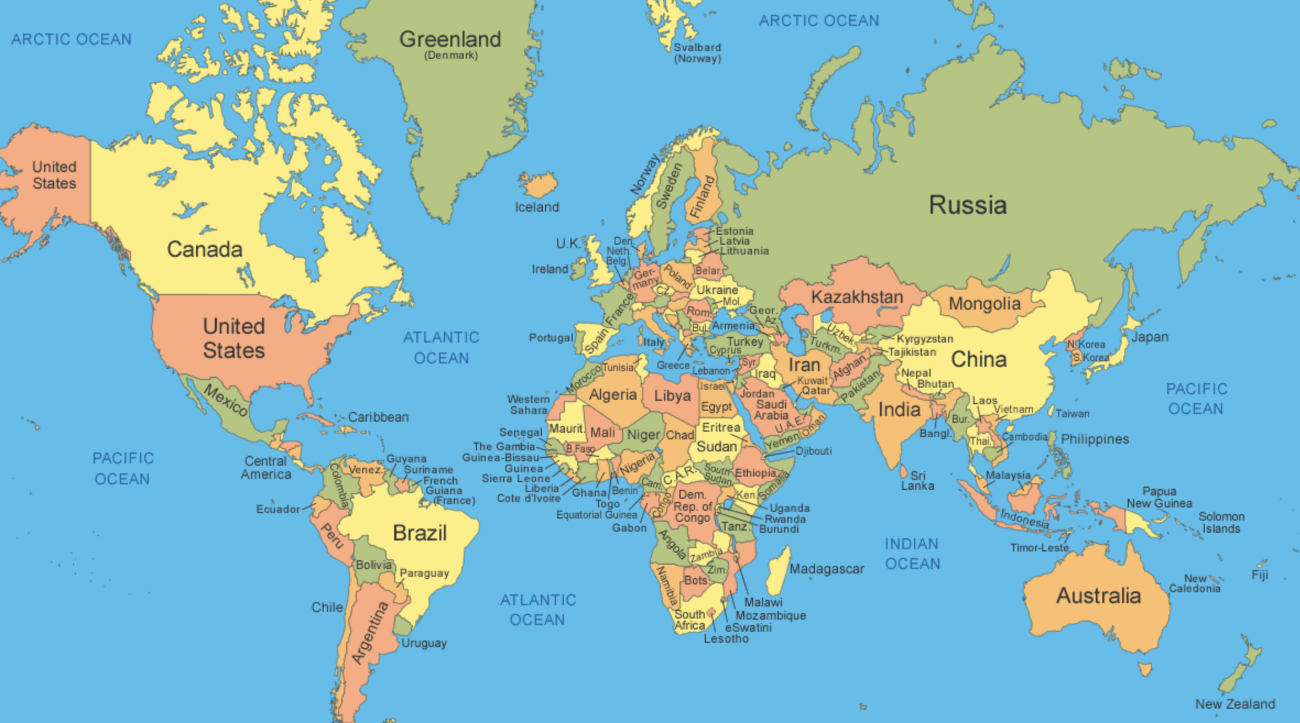
THANK YOU!

